Slide 1


Built-in
A GenAI-Based System for Verifying Compliance Between Floorplans Versions
Afik Aharon, Adi Haim, Liran Aichnboim

Slide 2




Motivating Use Case
BACKGROUND:
IMPORTANCE:
DIFFERENT FLOORPLAN VERSIONS CAUSE INCONSISTENCIES THAT BUYERS CANNOT EASILY VERIFY.
UNDETECTED CHANGES CREATE FINANCIAL RISKS FOR BUYERS AND LEGAL EXPOSURE FOR CONTRACTORS.
THE CHALLENGE:
CURRENT SOLUTIONS:
FLOORPLAN COMPARISON IS COMPLEX, AND THE LACK OF DOMAIN-SPECIFIC DATA REQUIRES CUSTOM DATASET GENERATION.
NO EXISTING TOOLS FROM THE BUYER’S PERSPECTIVE.
Notes:
Background:
Differences occure between diefferent versions of floorplans during planning.
buyers dont have a way of making sure their requests are being taken care of proffesionaly
Importance:
Undetected differences /changes lead to financial loss for buyers and costly legal disputes for contractors.
The Challenge:
Automating alignment and comparison between floorplans images and dense technical drawings is difficult for standard algorithms.
Current Solutions:
No market solution exists. Tools like ShapeDo focus on engineering revisions but only used by the constructor side, not on verifying "Promised vs. Built" specifications for the buyer.

Slide 3



Project task description
FORMAL PROBLEM STATEMENT
INPUTS & OUTPUTS
AUTOMATICALLY DETECT AND REPORT DIFFERENCES BETWEEN TWO VERSIONS OF THE SAME FLOORPLAN (1–2 BEDROOM APARTMENTS).
INPUT:
2 FLOORPLANS VERSIONS (IMAGE)
OUTPUT:
0 – NO MEANINGFUL CHANGE
1 – CONTENT CHANGE
PROJECT NOVELTY
FIRST BUYER-ORIENTED FLOORPLAN COMPARISON USING CV + GENERATIVE AI AND SYNTHETIC DATA.
Notes:
Formal Problem Statement:
Automatically detect and report differences between two versions of the same floorplan to validate “promised vs. built” compliance (1–2 bedroom apartments).
OUTPUT:
0 – No meaningful change (same layout, only style/line variations).
1 – Content change (room moved, size changed, walls shifted, etc.).
Project Novelty:
First blueprint-comparison tool built for buyers, not only professionals.
Combines Computer Vision + Generative AI to compare blueprint versions.
Uses synthetic plan generation to train the model on realistic variations.
Provides visual + textual explanations understandable to non-experts.

Slide 4



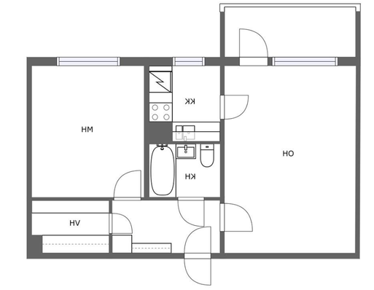

Models and methods
PIPELINE
TECHNIQUES
ADJUSTMENTS / FINE-TUNING
STAGE 1:
Input
PREPROCESSING: INPAINTING & FINE-TUNING
STAGE 2:
SYNTHETIC DATA
FEATURE EXTRACTION: CNN / VIT
COMPARISON: BETWEEN EMBEDDINGS & BINARY CLASSIFIER
OUTPUT
INPAINTING: DIFFUSION MODEL + PROMPT ENGINEERING
ENCODERS: CNN / VIT
CLASSIFIER
Light LoRA FINE-TUNING
THRESHOLD CALIBRATION
Notes:
Pipeline:
Input: one floor plan (database)
Preprocessing: inpainting and fine-tuning to create a second floorplan
Synthetic Data: Controlled edits via diffusion inpainting (doors/windows/walls)
Feature Extraction: CNN / ViT encoders → embeddings
Comparison: Difference between embeddings → binary classifier
Output: 0 = identical, 1 = changed
Techniques:
Inpainting: Diffusion model + prompt engineering
Encoders: CNN / ViT - for comparing embaddings
(we may compare differently)
Classifier: Small MLP for change detection
Adjustments / Fine-Tuning:
Light LoRA fine-tuning on floor-plan style
Threshold calibration for 0/1 decision

Slide 5




Data Specification & Generation
TRAINING & EVALUATION REQUIREMENTS
SYNTHETIC DATA GENERATION
GENERATE PLAN VARIATIONS
CREATE:
NO CHANGE PAIRS
CHANGED PAIRS
FLOORPLANS - 1–2 ROOMS
UNIFIED IMAGE FORMAT
PAIRED SAMPLES
DATASET USED:
LABELING
FLOORPLANSV2 (HUGGINGFACE) - FILTERED.
PAIR LABELING:
0 – STYLISTIC DIFFERENCES ONLY
1 – STRUCTURAL MODIFICATION
Notes:
Training & Evaluation Requirements:
Floorplans of 1–2 room apartments
Unified image format (size, orientation, clarity)
Paired samples for binary change detection
Labeling:
Automatic pair labeling:
0 – stylistic differences only
1 – structural modification
Dataset Used:
FloorPlansV2 (HuggingFace) - Filtered for small residential units
Synthetic Data Generation:
Generate plan variations using AI inpainting / floorplan editing APIs
Create:
No-change pairs → only visual edits
Change pairs → small structural edits (walls, doors, fixtures)

Slide 6



Metrics and KPIs
HOW WE MEASURE RESULTS:
QUALITY PER STEP:
METRICS & PROTOCOLS:
COMPARE MODEL PREDICTIONS
EVALUATE ABILITY TO DETECT SMALL, LOCAL CHANGES.
INPAINTING
EMBEDDINGS
CLASSIFIER
TRAIN/TEST SPLIT + CROSS-VALIDATION.
PAIRED FLOOR PLANS WITH BEFORE/AFTER LABELS.
KPIS
THESE METHODS MAY CHANGE DURING THE PRODUCTION
Notes:
How we measure results:
Compare model predictions to ground-truth labels (0/1).
Evaluate ability to detect small, local changes.
Quality per step:
Inpainting: Architectural style consistency, clean line continuity.
Embeddings: Clear separation between “changed” vs. “unchanged” pairs.
Classifier: Accuracy, Precision, Recall, F1-score.
Metrics & protocols:
Use train/test split + cross-validation.
Ground truth: paired floor plans with before/after labels.
KPIs: ≥80% accuracy, high recall, high visual consistency.

Slide 7
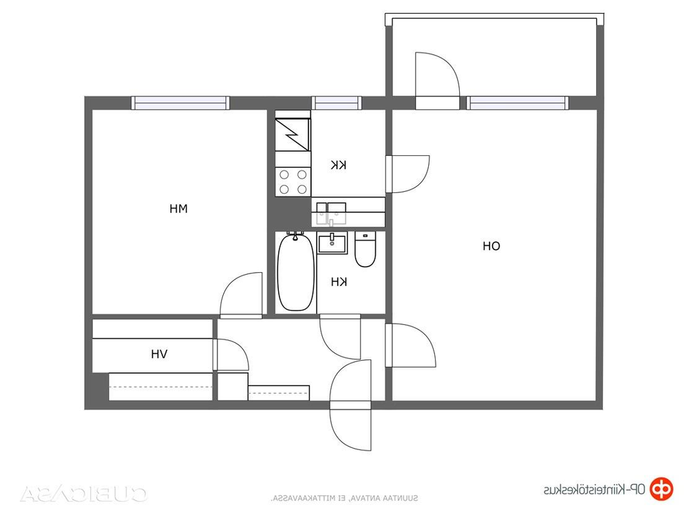
Example 1
BEFORE:
AFTER:
output: 0 – stylistic differences only

Slide 8


Example 2
BEFORE:
AFTER:
output: 1 – structural modification

